Slide 1
Goodbye to subscribe inside subscribe in FordPass I
Karam El-loh
Ford Motor company

Slide 2
Disclaimer!!!!!
The purpose of this presentation is to apply different techniques to solve ”subscribe inside subscribe/subscribe inside doOnX”.
These changes are not going to be merged.
Some parts of the code have been omitted to better illustrate the examples shown.

Slide 3
Quick review of the autocomplete example
Notes:
1 dimension ( zone lighting) , 2 dimension ( find example) , 3 dimension ( srs)

Slide 4
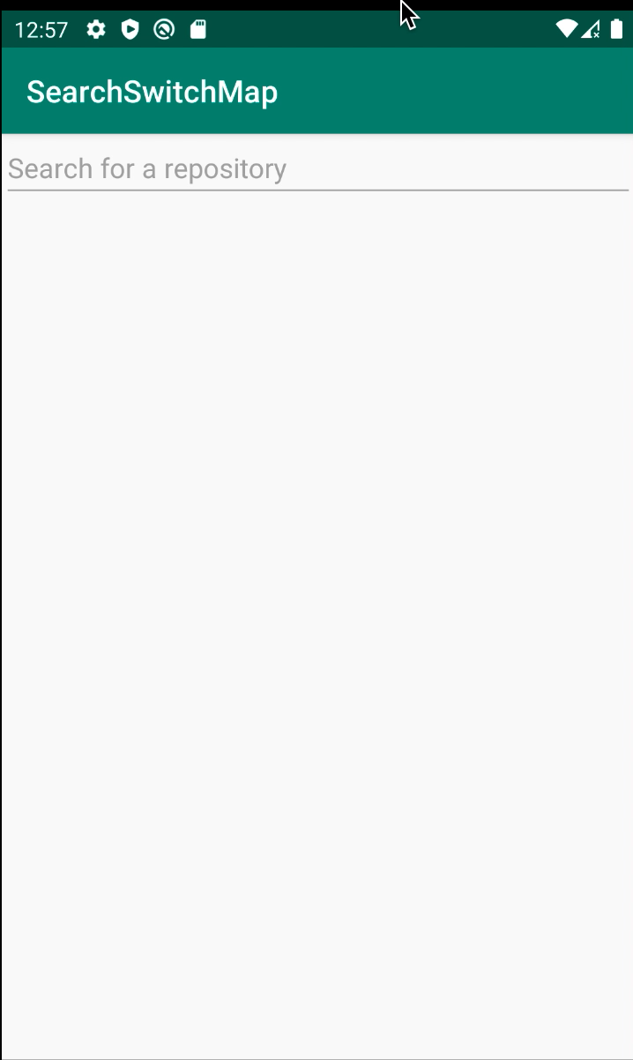
A demo of what the search box should look like

Slide 5
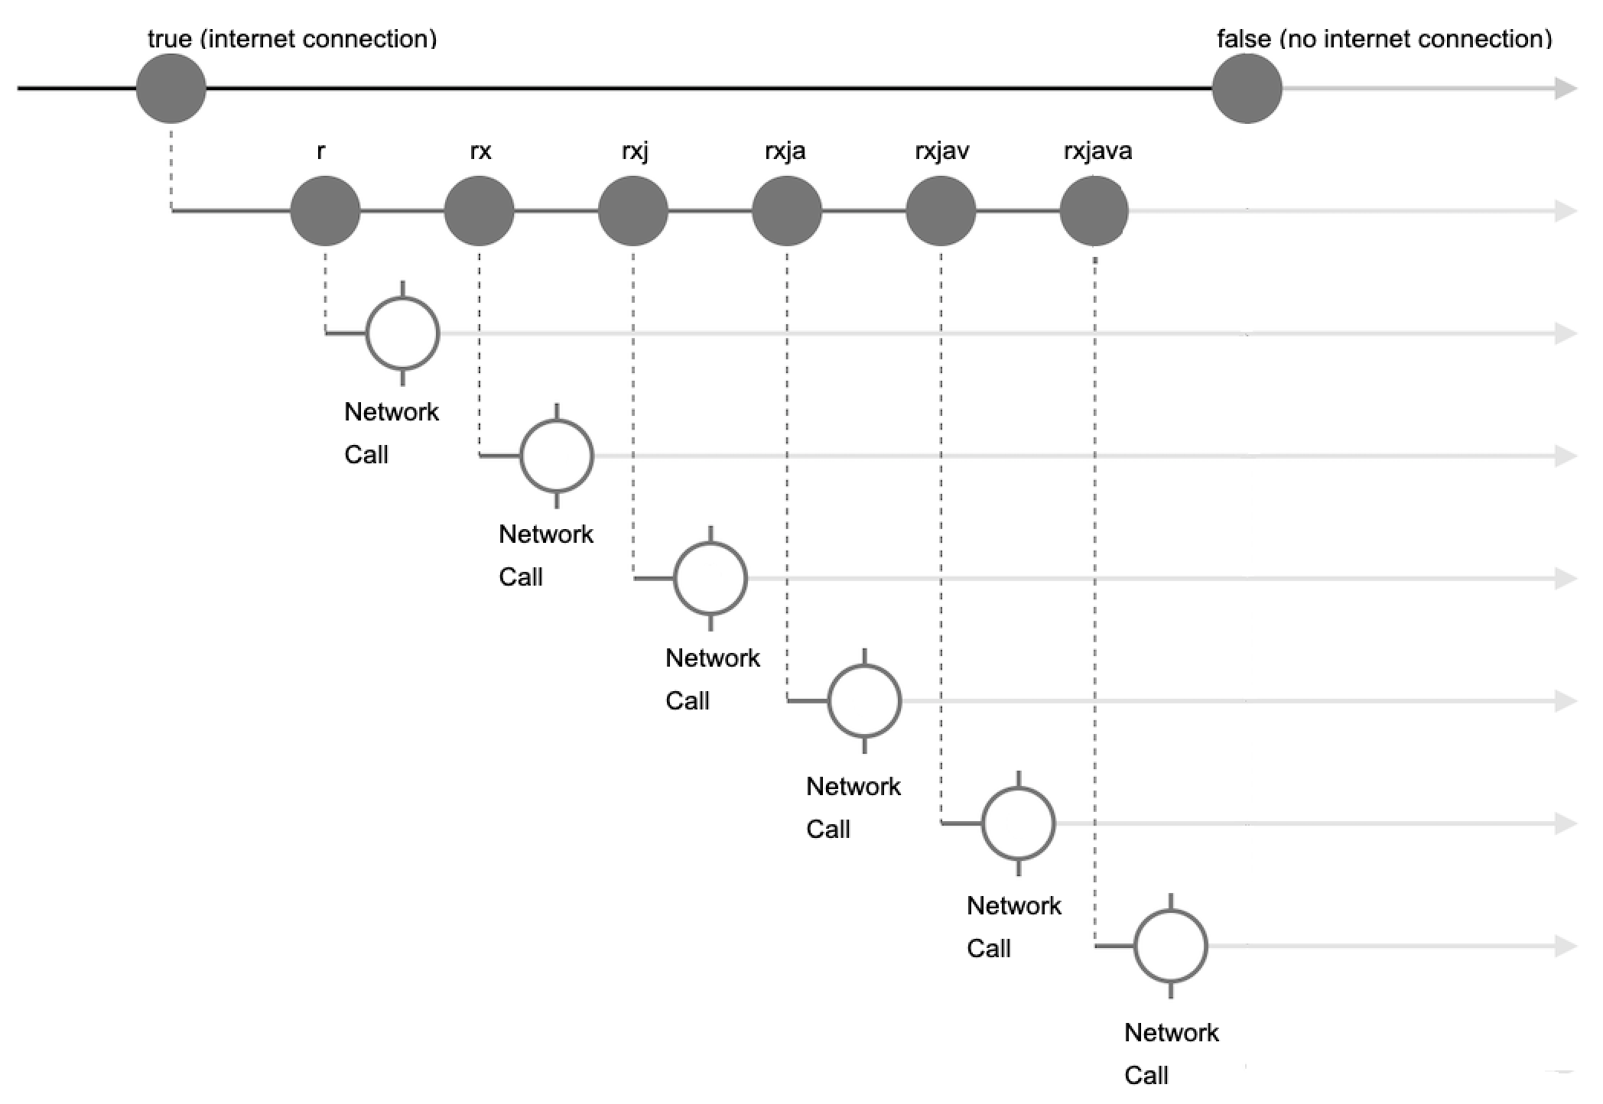
Autocomplete example

Slide 6
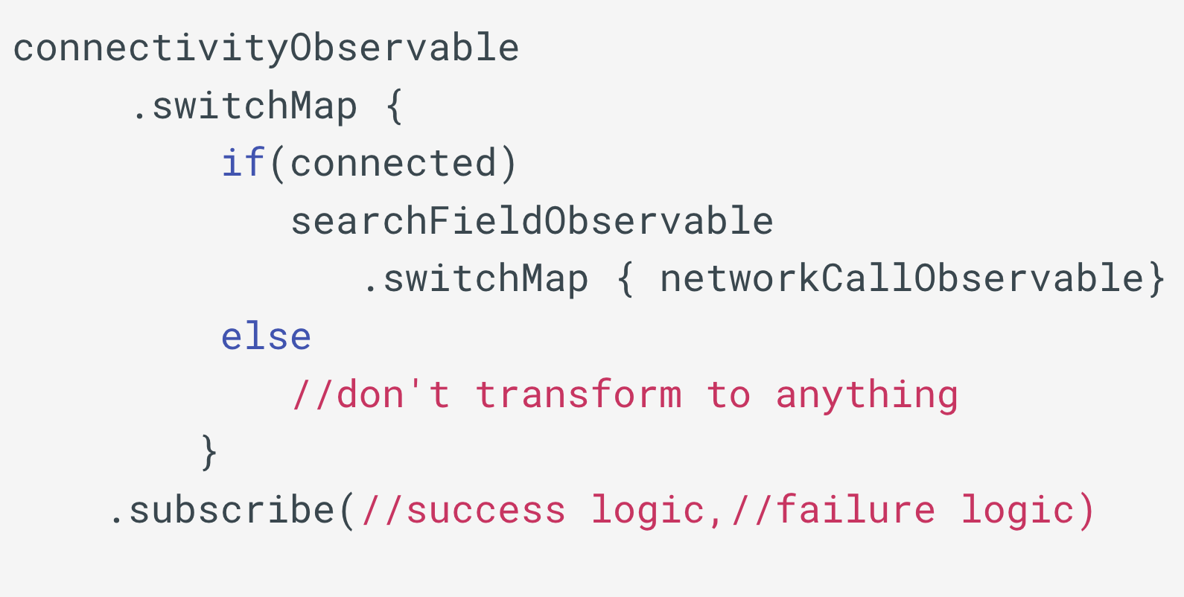
Autocomplete pseudocode

Slide 7
Autocomplete example – first dimension only

Slide 8
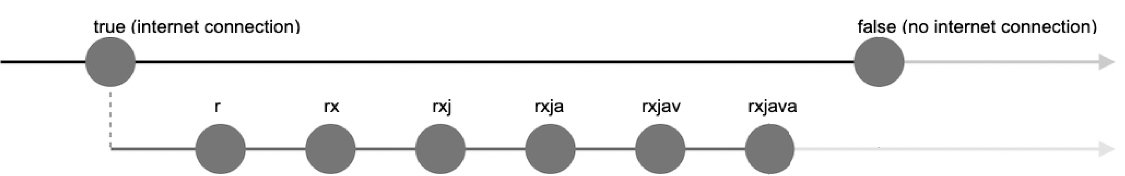
Autocomplete example – first and second dimension

Slide 9
Autocomplete example – all dimensions

Slide 10
Problems faced in subscribe inside subscribe
Breaking consistent error behavior
Potential leaks (Memory/Resource)
Unintended behavior
Not easy to change threads
Code not easy to read/imperative
Notes:
We know in rxjava that error behaviour is “eager” , which means that if an error happens in one dimension/observable , everything else is going to be canceled/disposed
Now , that is not the case with subscribe inside subscribe. If an error happens in sub inside sub, the other observables are not canceled, you have to manually cancel them. This is not the desired behavior, because if things are properly hcained, we have more control over what happens in an error scenario. Ex: we may want to cancel everything, which is the default behavior, or we may want to keep the chain going, or we may want to emit a defualt value in case of an error. Those options are not easy to achieve in sub inside sub as they are when everything is properly chained
That also flows into number 2, where if an error happens, the other observable is not disposed, which may cause memory leaks.
In addition, we can have unintended behavior. Recall in a previous presetnation where we saw inconsitent ui if a network call is delayed. That was because that network call was not disposed when we made a new one

Slide 11

Overview of the three examples
Zone Lighting – solved in 1D
Find - solved in 2D
Scheduled Remote Start – solved in 3D

Slide 12
First example - Zone Lighting

Slide 13
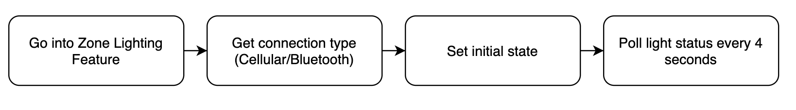
Zone Lighting Polling High Level Diagram

Slide 14
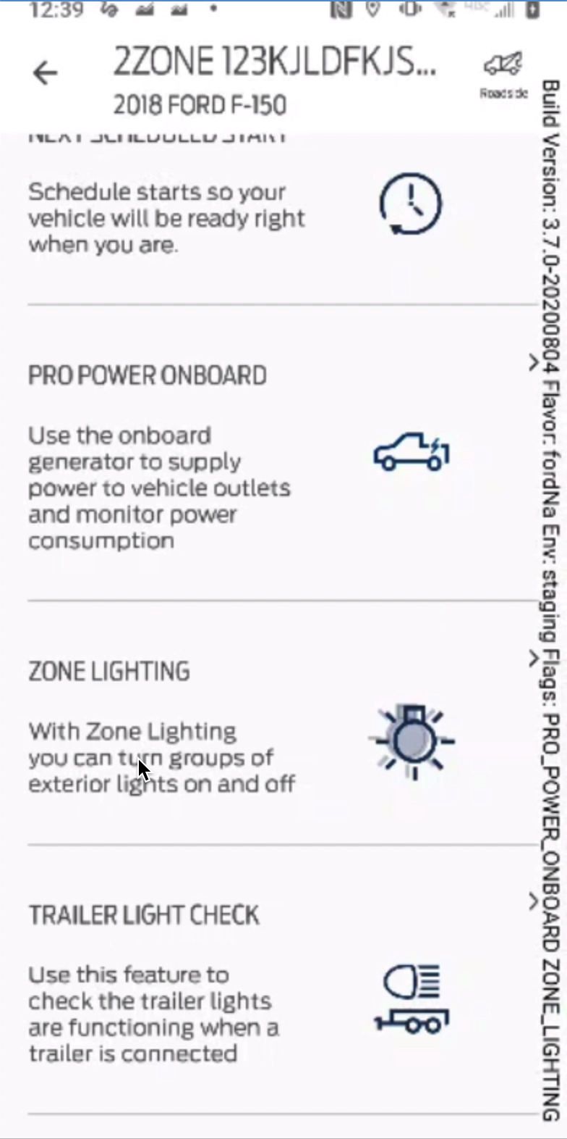
Zone Lighting
In master

Slide 15
Poll Zone Lighting Status - Code
fun pollZoneLightingStatus() { getConnection() .doOnNext(setInitialState()) .switchMap { connectionType -> startPollingVehicleStatus(connectionType) } .subscribe({setZoneLights(zoneLightUiModel) } }

Slide 16
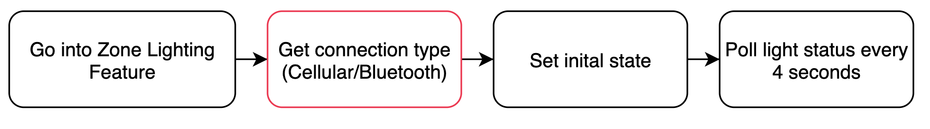
Poll Zone Lighting Status - Code
fun pollZoneLightingStatus() { getConnection() .doOnNext(setInitialState()) .switchMap { connectionType -> startPollingVehicleStatus(connectionType) } .subscribe({setZoneLights(zoneLightUiModel) } }

Slide 17
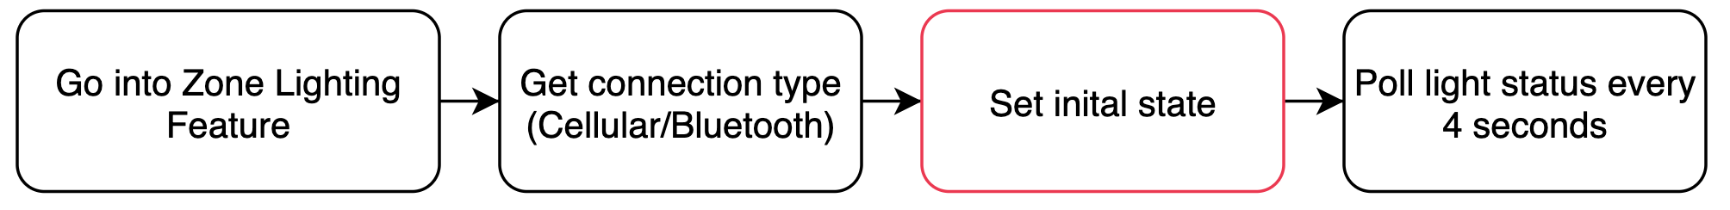
Poll Zone Lighting Status - Code
fun pollZoneLightingStatus() { getConnection() .doOnNext(setInitialState()) .switchMap { connectionType -> startPollingVehicleStatus(connectionType) } .subscribe({setZoneLights(zoneLightUiModel) } }

Slide 18
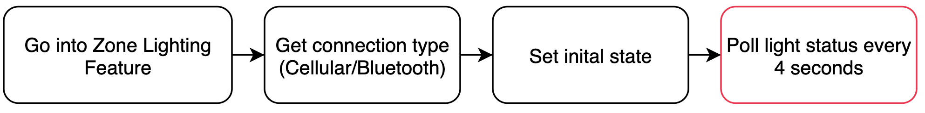
Poll Zone Lighting Status - Code
fun pollZoneLightingStatus() { getConnection() .doOnNext(setInitialState()) .switchMap { connectionType -> startPollingVehicleStatus(connectionType) } .subscribe({setZoneLights(zoneLightUiModel) } }

Slide 19
The Problem
fun pollZoneLightingStatus() { getConnection() .doOnNext(setInitialState())
…. }
fun setIntialState() {
setConnectionState()
setTimeStamp()
fetchZoneLighting() → // This is a vstat call }
Problems:
1. Break consistent error behavior
2. Code not easy to read/imperative
Notes:
Fetch zone lighting and polling observable same call, may want tocancel everything if first fails
If the first call is delayed for 3 seconds, polling observable starts at 4, UI may look weird if you have loading spinner etc..

Slide 20
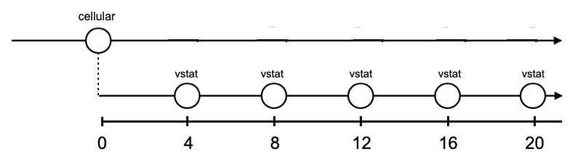
ZoneLighting Polling Marble Diagram (What we have)
doOnNext (vstat call) →
Connection
Observable
Polling Observable
Time (s)

Slide 21
ZoneLighting Polling Marble Diagram (what we want)
Connection
Observable
Polling Observable
Time (s)

Slide 22
Fixing it
fun pollZoneLightingStatus() { getConnection() .doOnNext(setInitialState()) .switchMap { connectionType -> startPollingVehicleStatus(connectionType)
.startWith(fetchZoneLighting()) } .subscribe({setZoneLights(zoneLightUiModel) } }
Problems:
1. Break consistent error behaviour
2. Code not easy to read/imperative

Slide 23
Before fix
After fix

Slide 24
Second example – Autocomplete search in Find

Slide 25
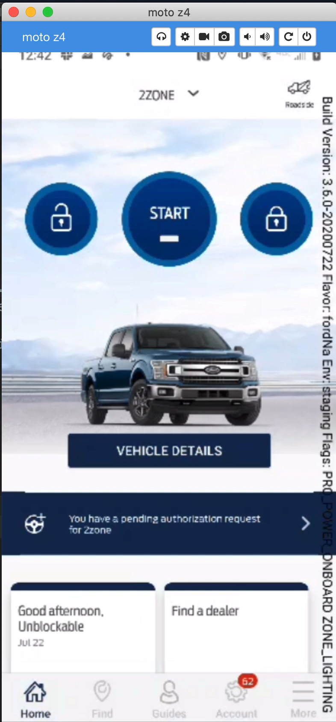
Find autocomplete search in master

Slide 26
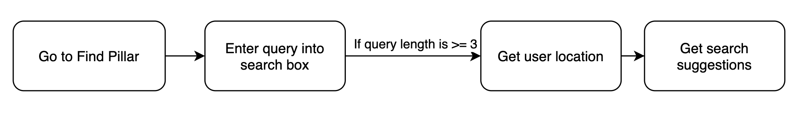
Find autocomplete - High Level Diagram

Slide 27
Find Autocomplete Search
fun onTextChanged(query) {
if( query.length >= 3 )
getLocation()
.subscribe { location ->
getSuggestions(query,location) }
}

Slide 28
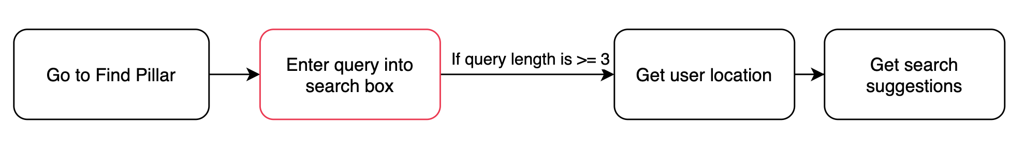
Find Autocomplete Search - Code
fun onTextChanged(query) {
if( query.length >= 3 )
getLocation()
.subscribe { location ->
getSuggestions(query,location) }
}

Slide 29
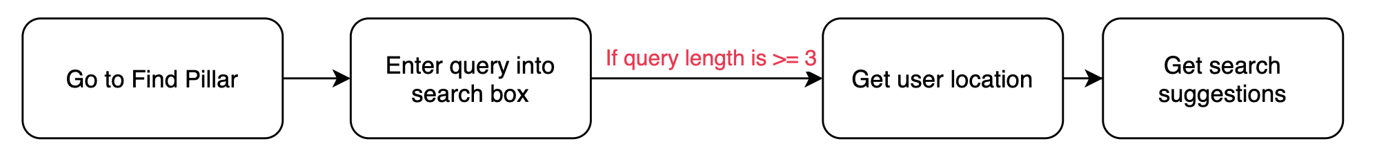
Find Autocomplete Search - Code
fun onTextChanged(query) {
if( query.length >= 3 )
getLocation()
.subscribe { location ->
getSuggestions(query,location) }
}

Slide 30
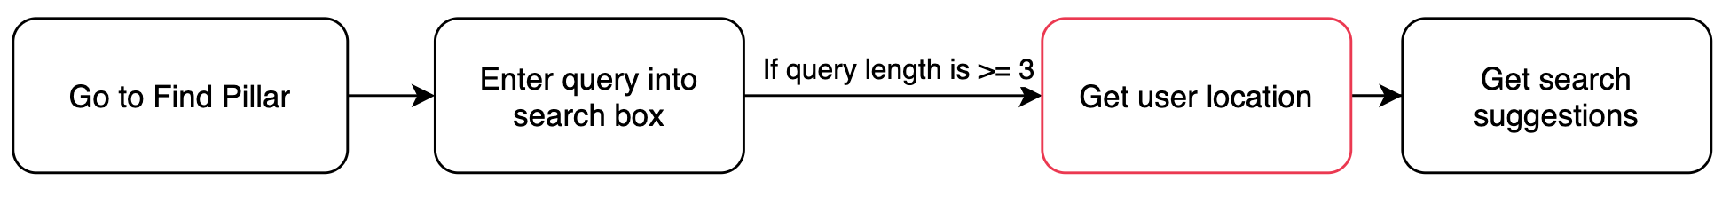
Find Autocomplete Search - Code
fun onTextChanged(query) {
if( query.length >= 3 )
getLocation()
.subscribe { location ->
getSuggestions(query,location) }
}

Slide 31
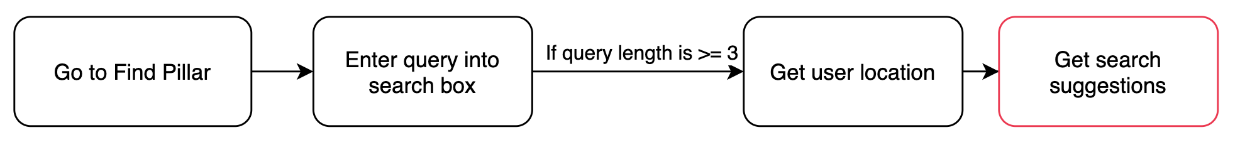
Find Autocomplete Search - Code
fun onTextChanged(query) {
if( query.length >= 3 )
getLocation()
.subscribe { location ->
getSuggestions(query,location) }
}

Slide 32
The Problem
fun onTextChanged(query) {
…
.subscribe { location -> getSuggestions(query,location) }}
fun getSuggestions(query , location) {
device = Device(location.lat , location.long)
getAutoCompleteSuggestions(device,query)
.subscribe (::processResponse)
Problems:
Breaking consistent error behavior
Leaking resources
Notes:
If suggestion fails, gps will not turn off, and battery will drain fast because gps is always on (memory leak) iif sub inside sub

Slide 33
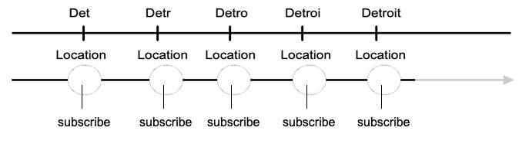
onTextChanged
Location
Observable
What we have

Slide 34
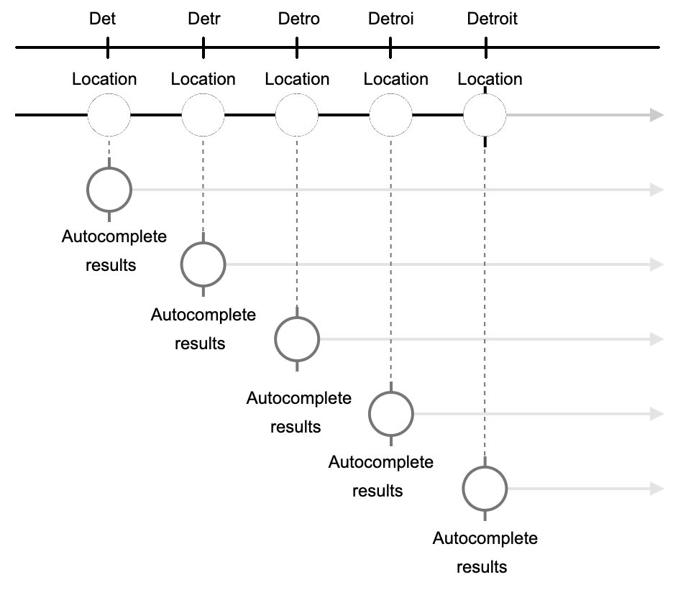
onTextChanged
Location
Observable
What we want

Slide 35
Fixing it
Problems:
Breaking consistent error behavior
Leaking resources
fun onTextChanged(query) {
if( query.length >= 3 )
getLocation()
.switchMap{ location ->
getSuggestionsObservable(query,location) }
.subscribe(::processResponse)

Slide 36
Third example – Scheduled Remote Start

Slide 37
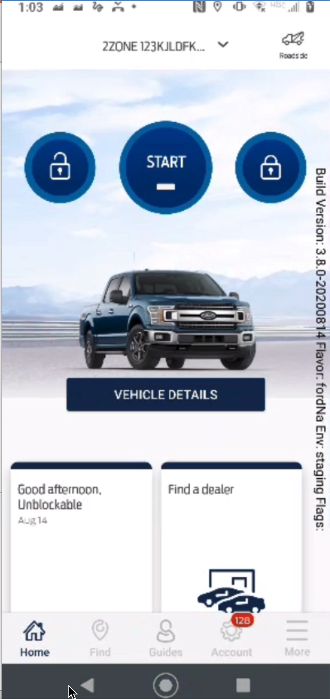
Scheduled
Remote
Start in master

Slide 38
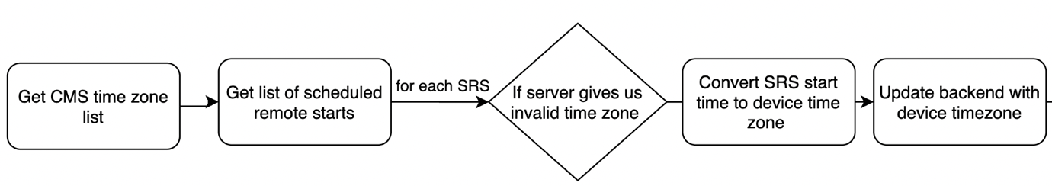
Scheduled Remote Start- High Level Diagram

Slide 39
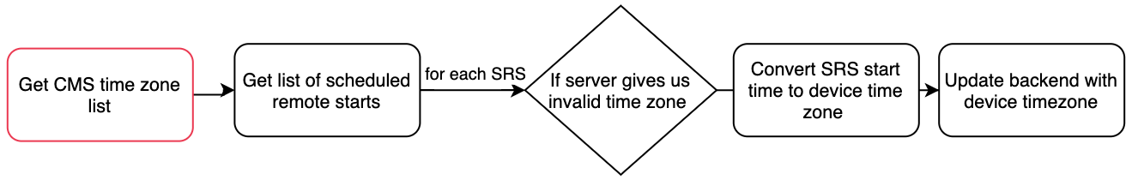
Load Scheduled Remote Start - Code
fun loadSRS() {
getCmsTimeZoneList()
.subscribe(::fetchScheduledStarts)

Slide 40
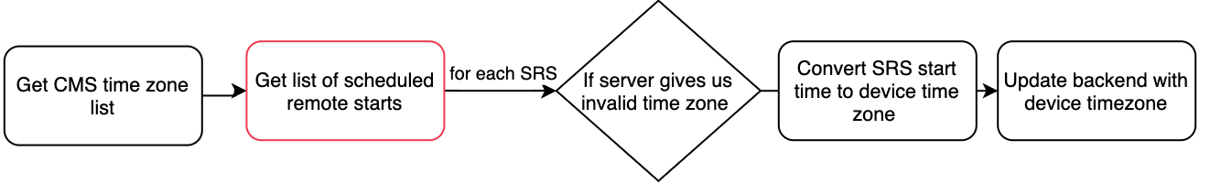
Load Scheduled Remote Start - Code
fun fetchScheduledStarts(cmsTimeZoneList) {
this.cmsTimeZoneList = cmsTimeZoneList
fetchScheduledStartsList()
.subscribe(::handleTimeZonesAndUpdateDisplay)

Slide 41
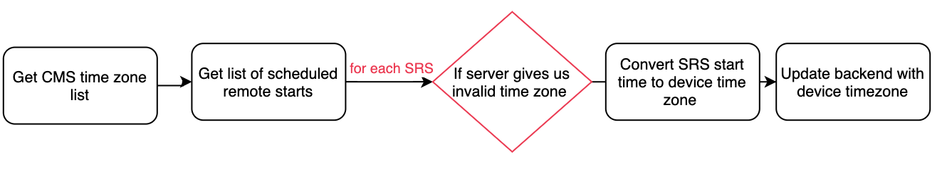
Load Scheduled Remote Start - Code
fun handleTimeZonesAndUpdateDisplay(scheduledStartList) {
foreach(scheduledStartList)
if(invalidTimeZone(SRS))
convertSrsToDeviceTimeZone(SRS)
updateBackendWithDeviceTimeZone(SRS)
}

Slide 42
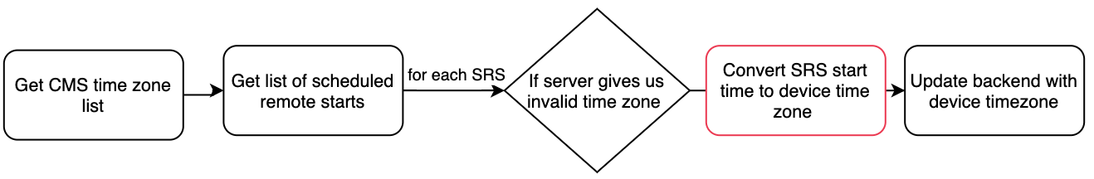
Load Scheduled Remote Start - Code
fun handleTimeZonesAndUpdateDisplay(scheduledStartList) {
foreach(scheduledStartList)
if(invalidTimeZone(SRS))
convertSrsToDeviceTimeZone(SRS)
updateBackendWithDeviceTimeZone(SRS)
}

Slide 43
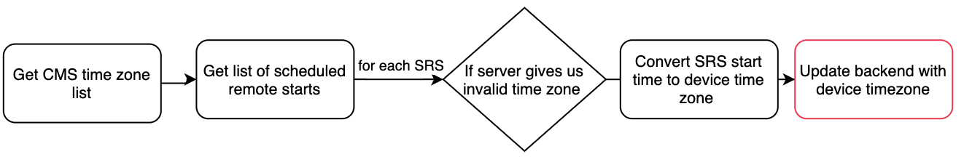
Load Scheduled Remote Start - Code
fun handleTimeZonesAndUpdateDisplay(scheduledStartList) {
foreach(scheduledStartList)
if(invalidTimeZone(SRS))
convertSrsToDeviceTimeZone(SRS)
updateBackendWithDeviceTimeZone(SRS)
}

Slide 44
Load Scheduled Remote Start - Code
fun handleTimeZonesAndUpdateDisplay(scheduledStartList) {
foreach(scheduledStartList)
if(invalidTimeZone(SRS))
convertSrsToDeviceTimeZone(SRS)
updateBackendWithDeviceTimeZone(SRS)
}
fun updateBackendWithDeviceTimeZone(SRS) {
updateScheduledStart(SRS).subscribe()

Slide 45
The Problem
fun loadSRS() {
getCmsTimeZoneList()
.subscribe {
fetchScheduledStartsList()
.subscribe {
if(invalidTimeZone(SRS))
….
updateScheduledStart(SRS)
.subscribe()
} } }
Problems:
Breaking consistent error behavior
Not easy to change threads
Code not easy to read/imperative

Slide 46
Our objectives
Get rid of the class level variable
Get rid of for loop
Get rid of (subscribe inside subscribe)³
Notes:
3. Imperative code will be unmaintainable, and introduce state machines, lose all benefits of declarative code

Slide 47
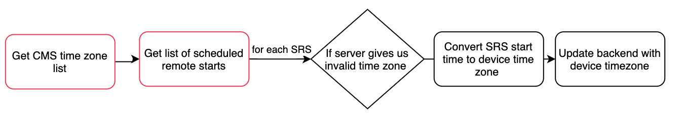
Fixing it
fun loadSRS() {
getCmsTimeZoneList().zipWith(fetchScheduledStartsList())
.flatMap { cmsList , srsList ->
…
}

Slide 48
Our objectives
Get rid of class level variable
Get rid of for loop
Get rid of subscribe inside subscribe
Notes:
3. Imperative code will be unmaintainable, and introduce state machines, lose all benefits of declarative code

Slide 49
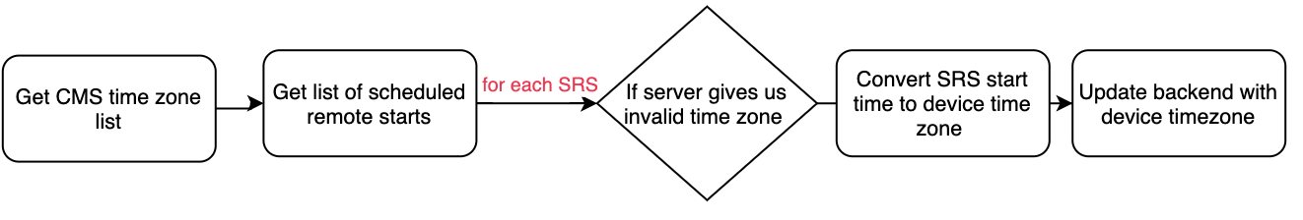
Fixing it
fun loadSRS() {
getCmsTimeZoneList().zipWith(fetchScheduledStartsList())
.flatMap { cmsList , srsList ->
Observable.fromIterable(srsList)
}
…
}

Slide 50
Our objectives
Get rid of class level variable
Get rid of for loop
Get rid of subscribe inside subscribe
Notes:
3. Imperative code will be unmaintainable, and introduce state machines, lose all benefits of declarative code

Slide 51
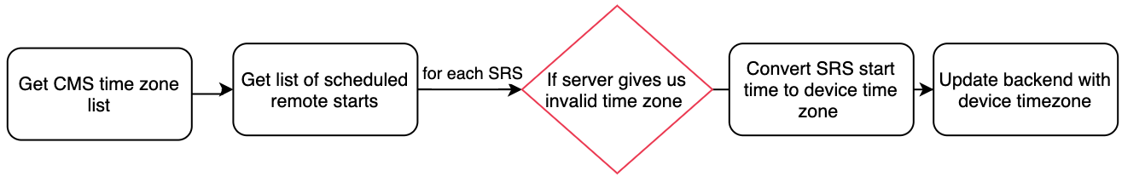
Fixing it
fun loadSRS() {
..
.flatMap { cmsList , srsList ->
Observable.fromIterable(srsList)
.flatMap { scheduledStart ->
if(invalidTimeZone(scheduledStart,cmsList)

Slide 52
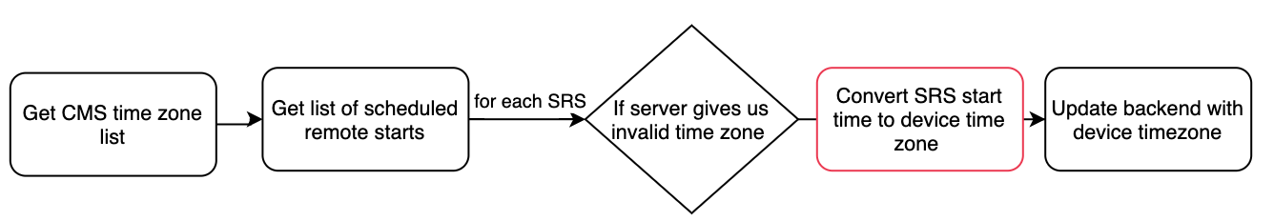
Fixing it
fun loadSRS() {
..
.flatMap { cmsList , srsList ->
Observable.fromIterable(srsList)
.flatMap { scheduledStart ->
if(invalidTimeZone(scheduledStart,cmsList)
convertSrsToDeviceTimeZone(scheduledStart)
return updateScheduledStart(scheduledStart) }

Slide 53
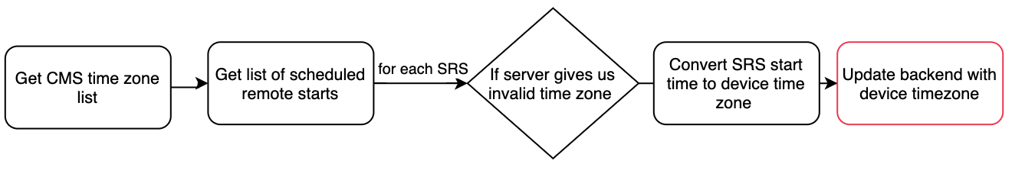
Fixing it
fun loadSRS() {
..
.flatMap { cmsList , srsList ->
Observable.fromIterable(srsList)
.flatMap { scheduledStart ->
if(invalidTimeZone(scheduledStart,cmsList)
convertSrsToDeviceTimeZone(scheduledStart)
return updateScheduledStart(scheduledStart) }

Slide 54
Final RxJava chain
fun loadSRS() { getCmsTimeZoneList().zipWith(fetchScheduledStartsList()) .flatMap { cmsList,srsList -> return Observable.fromIterable(srsList) .flatMap { scheduledStart -> if(invalidTimeZone(scheduledStart,cmsList)
convertSrsToDeviceTimeZone(scheduledStart)
return updateScheduledStart(scheduledStart) else ... } } .subscribe(::showResults)}

Slide 55
Our objectives
Get rid of class level variable
Get rid of for loop
Get rid of subscribe inside subscribe
Notes:
3. Imperative code will be unmaintainable, and introduce state machines, lose all benefits of declarative code

Slide 56
Final RxJava chain
fun loadSRS() { getCmsTimeZoneList().zipWith(fetchScheduledStartsList()) .flatMap { cmsList,srsList -> return Observable.fromIterable(srsList) .flatMap { scheduledStart -> if(invalidTimeZone(scheduledStart,cmsList)
convertSrsToDeviceTimeZone(scheduledStart)
return updateScheduledStart(scheduledStart) else ... } } .subscribe(::showResults)}
Problems:
Breaking consistent error behavior
Not easy to change threads
Code not easy to read/imperative

Slide 57
Final RxJava chain
fun loadSRS() { getCmsTimeZoneList().zipWith(fetchScheduledStartsList()) .flatMap { cmsList,srsList -> return Observable.fromIterable(srsList) .flatMap { scheduledStart ->
updateBackendIfRemoteStartInvalid(scheduledStart) } } .subscribe(::showResults)}

Slide 58
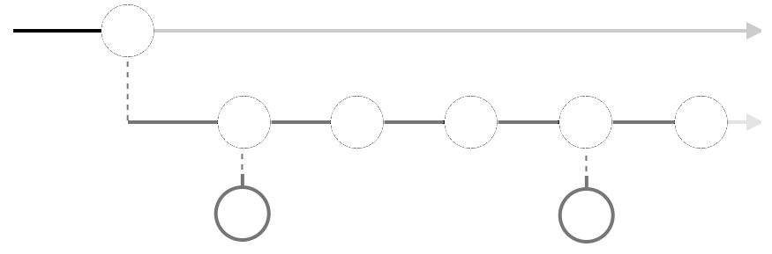
(cmsTimeZoneList,scheduledRemoteStartList )
cmsList.zipWith(srsList)
Observable.fromIterable(srsList)
SRS
SRS
SRS
SRS
SRS
updateScheduledStart
( only if SRS timezone is invalid)
SRS after refactor: Marble Diagram

Slide 59
Summary of the three examples
Zone Lighting – used startWith to combine polling observable with one shot vstat call
Find – used switchMap to push suggestions observable to second dimension
Scheduled Remote Start – 1) combined cmsTimeZoneList and fetchSRS calls using zip. 2) used Observable.fromIterable to get rid of for loop. 3) used flatMap again to update SRS that have invalid time zone
1.
2.
3.

Slide 60
RxJava Schedule
Goodbye to subscribe inside subscribe in FordPass I <----- We are here
Goodbye to subscribe inside subscribe in FordPass II
Wrapping a callback into an observable
Introduction to schedulers in RxJava
...
Notes:
3. Imperative code will be unmaintainable, and introduce state machines, lose all benefits of declarative code

Slide 61
Subscribe inside subscribe
FordPass

